Slide 1
ARDUINO - Shift Registers
Understanding the 74HC595 SIPO IC
Master Reset Function
Have you ever wondered what the 74HC595 Master Reset pin does and how it works? We invariably skim over this and simply keep the pin high by hard wiring it to +5v and all works fine.
In this tutorial we look at what this pin does and how we can use it programmatically to control the 74HC595 shift register.

Slide 2
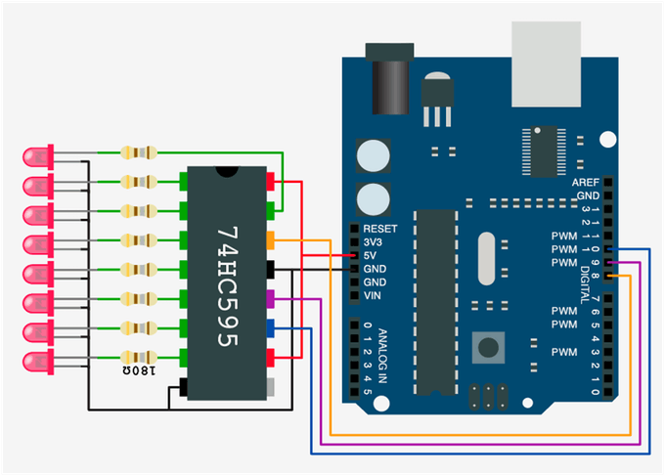
74HC595 with Programmatic
Master Reset
Button switch,
simply connected
220 ohm

Slide 3
Microcontroller 74HC595
Pin Pin
8 14 (SER) data in
9 12 (RCLK) latch
10 11 (SRCLK) clock
11 10 (SRCLR) master reset
12 Switch Pin

